Slide 1
Actuator Usage and Fault Tolerance of the James Webb Space Telescope Optical Telescope Element Mirror Actuators
Allison A. Barto, D. Scott Acton, Paul Finley, Benjamin B. Gallagher,
Bruce Hardy, J. Scott Knight, Paul A. Lightsey
Ball Aerospace & Technologies Corp.
1600 Commerce Street
Boulder, CO 80301, USA paper 8442-88
SPIE Symposium on Astronomical Telescopes and Instrumentation
Space Telescopes and Instrumentation 2012:
Optical, Infrared, and Millimeter Wave Conference
Amsterdam, Netherlands
01 - 06 July 2012

Slide 2
Abstract
The James Webb Space Telescope (JWST) telescope’s secondary mirror and eighteen primary mirror segments are each actively controlled in rigid body position via six hexapod actuators. The mirrors are stowed to the mirror support structure to survive the launch environment and then must be deployed 12.5 mm to reach the nominally deployed position before the Wavefront Sensing & Control (WFS&C) alignment and phasing process begins. The actuation system is electrically, but not mechanically redundant. Therefore, with the large number of hexapod actuators, the fault tolerance of the OTE architecture and WFS&C alignment process has been carefully considered. The details of the fault tolerance will be discussed, including motor life budgeting, failure signatures, and motor life.

Slide 3
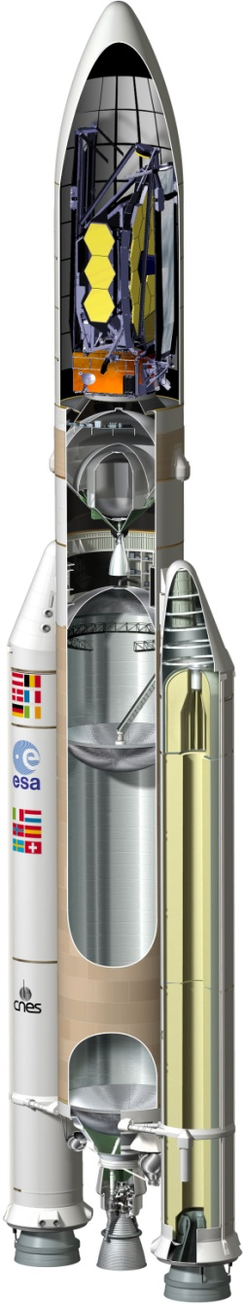
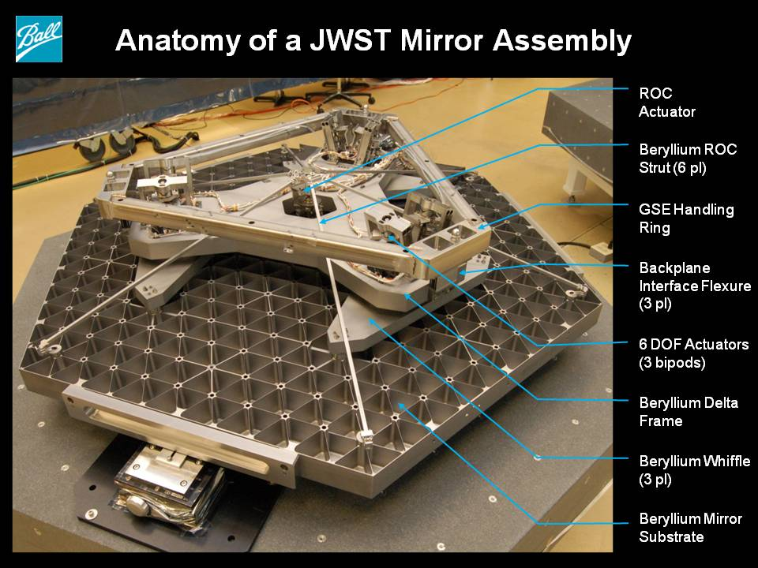
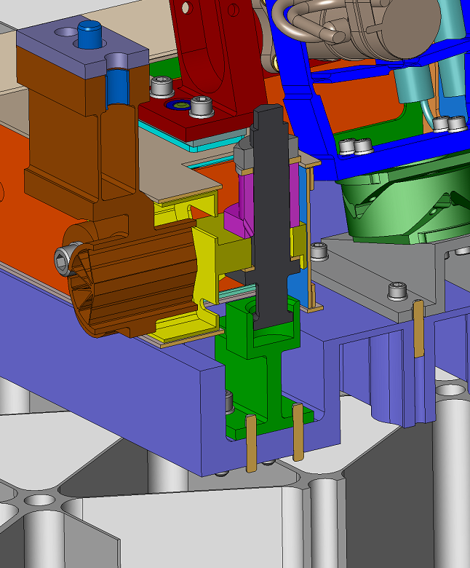
JWST Structure & Mirrors
Must Deploy In-Flight
JWST’s size necessitates the telescope be stowed for launch in a folded configuration and deployed in flight
Individual mirror segments must then have sufficient range to
Primary Mirror Segments (PMSAs) and Secondary Mirror Segment (SMA) are stowed to withstand launch loads
They must deploy 12.5 mm to reach nominal deployed configuration prior to beginning Wavefront Sensing & Control Commissioning

Slide 4
Considering Motor Failure
Given that Primary and Secondary Mirrors each begin 12.5 mm from their nominal operating position, it is necessary to assess
  Likelihood of failure / motor life
  Ability to predict early onset of failure during life of each motor
  Expected life if onset of failure is not detected prior to launch
  Impact of motor failure on mission performance should it occur in flight
  General consideration of fault tolerance in JWST alignment plans
Mirror motors are electrically, but not mechanically redundant
  Complete motor failure is considered in this presentation

Slide 5
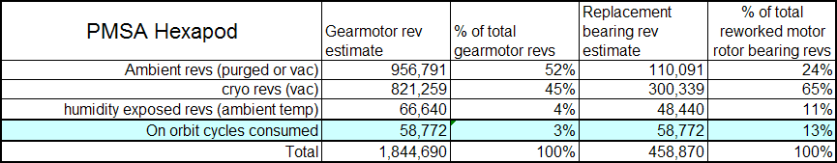
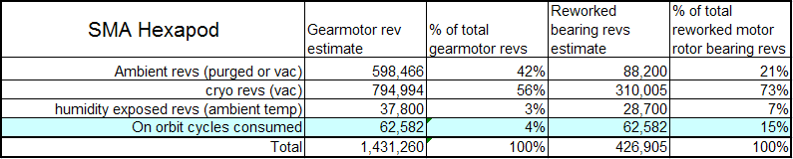
Actuator Range and Use Budgeting
Actuator use in flight is dependent on:
  Range to deploy to nominal mirror positions (12.5 mm)
  Total range from the nominal deployed position needed to compensate for segment and system-level manufacturing tolerances
  Efficiency of the Wavefront Sensing and Control (WFS&C) process to reach the final positions
Actuator use during ground I&T
must also be considered for
  Motor build and run-in
  Subsystem-level I&T
    Stow/deploy mirrors for optical
    testing
    Motor use to verify range and
    resolution of hexapod actuation system
  System I&T
    Confirm functionality after integration
    Stow/deploy mirrors for optical testing both pre/post environmental test & for cryo test
    Verification of WFS&C processes and calibration of system optical influence functions
Notes:
The allocation to the WFE following the WFSC process is structured to capture the active control nature of the system. The low spatial frequency residuals following WFSC are determined by the nature of the WFSC process that corrects and/or compensates low spatial frequency errors from misalignments or low spatial frequency polishing errors on the mirrors and within the SI optics. The mid and high frequency errors are determined by the more traditional control of mirror figure errors and SI WFE that are set before flight.

Slide 6
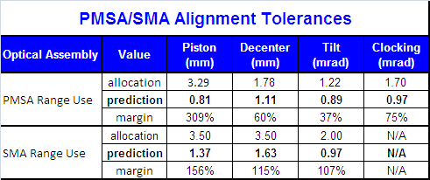
Determining Flight Actuator Usage
Actuator use in flight is dependent on:
  Range to deploy to nominal mirror positions (12.5 mm)
  Total range from the nominal deployed position needed to compensate for segment and system-level manufacturing tolerances
    Detailed budget has been developed to track the stack-up of all manufacturing tolerances
      Includes both mirror-placement alignment tolerances on the JWST structure as well as mirror range needed to compensate for optical fabrication tolerances
      Includes allocations for both the as-measured configuration and the uncertainty with which that final configuration can be measured/known
      Range to compensate optical figure and system-level alignment is determined via system Monte Carlo alignment analyses
  Efficiency of the Wavefront Sensing and Control (WFS&C) process to reach the final positions
Notes:
The allocation to the WFE following the WFSC process is structured to capture the active control nature of the system. The low spatial frequency residuals following WFSC are determined by the nature of the WFSC process that corrects and/or compensates low spatial frequency errors from misalignments or low spatial frequency polishing errors on the mirrors and within the SI optics. The mid and high frequency errors are determined by the more traditional control of mirror figure errors and SI WFE that are set before flight.

Slide 7
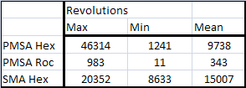
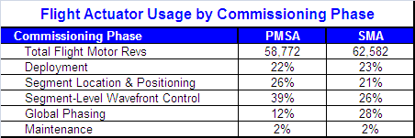
Determining Flight Actuator Usage
Actuator use in flight is dependent on:
  Range to deploy to nominal mirror positions (12.5 mm)
  Total range from the nominal deployed position needed to compensate for segment and system-level manufacturing tolerances
  Efficiency of the Wavefront Sensing and Control (WFS&C) process to reach the final positions
    Monte Carlo alignment analysis performed utilizing JWST WFS&C ground software and flight alignment processes
    “Segment Update Requests” from this analysis were interrogated to determine motor usage
    This motor use was then evaluated for each commissioning step to create a baseline flight process flow including conservatively estimating the number of iterations through each step should the system deploy near the edges of the tolerance stack-up described earlier
    Mirror range corrected at each step was allocated based on the total allocated tolerance stack-up
    Final flight motor usage by flight phase:
Notes:
The allocation to the WFE following the WFSC process is structured to capture the active control nature of the system. The low spatial frequency residuals following WFSC are determined by the nature of the WFSC process that corrects and/or compensates low spatial frequency errors from misalignments or low spatial frequency polishing errors on the mirrors and within the SI optics. The mid and high frequency errors are determined by the more traditional control of mirror figure errors and SI WFE that are set before flight.

Slide 8
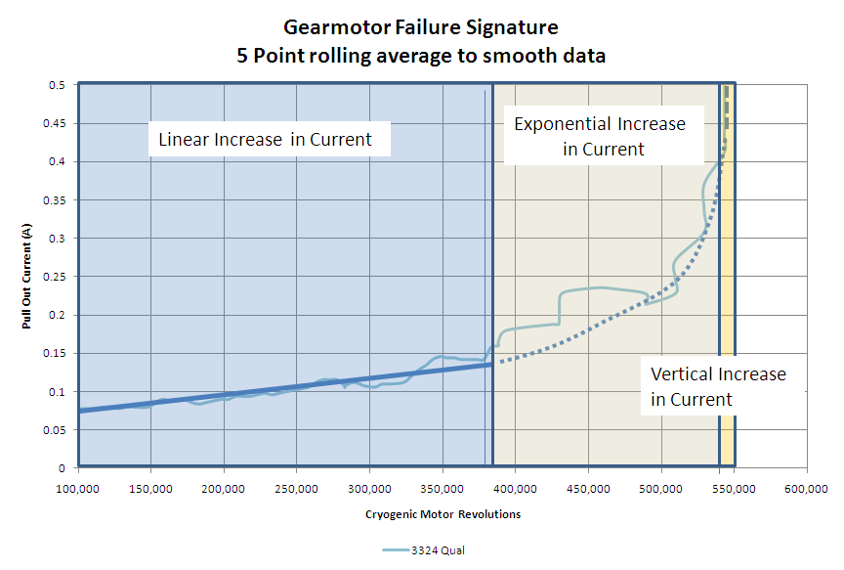
Predicting Actuator Life if Early Signs of Failure are Detected
Through successive iterations of JWST mirror gearmotor design and process control investigation, several motors were run to failure or onset of failure
Failures induced have all been bearing failures due to the introduction of debris into the bearing
In all instances, early signs of failure can be detected by plotting pull out current vs. number of gearmotor cycles
Typical plot shows three regimes:
  linear increase in pull-out current
  exponential increase in pull-out current
  near vertical increase in pull-out current
Data from the exponential portion of this
curve for 10 failure cases was fit to a
Weibull distribution to estimate the mean
time from onset of failure to motor failure
(defined as pull-out current > 0.4 amps)
For a single actuator, if pull-out current begins to rise, indicating onset of failure, the motor has a 95% chance of continuing to operate for 277,000 revolutions before failure
If early indication of motor failure is not caught prior to launch, likely still have
4-5x margin between required flight motor life (~60,000 revs) and remaining
motor life (277,000 revs)

Slide 9
Consideration of Failure Scenarios
Failure prior to subsystem delivery to Telescope I&T
  All hexapod motors are reworked with fresh bearings as the last step before delivery to system I&T
  Motor rework process includes screening and acceptance test to show motor health
  Only motor use following health tests above is to stow the mirror (10,000 revs)
Failure during system I&T
  Conservative motor use budget for system I&T is 214,000 revs for SMA motors and 250,000 revs for PMSA motors
  Pull-out current is monitored periodically during the test phase as plotted to look for early indicator of motor failure
  If necessary, motors could be reworked prior to launch
    Outer segments more readily accessible than inner segments
    Would consider pull-out current signature vs. remaining ground/flight motor use
Failure in flight – dependent on commissioning phase:
  Prior to deployment
  During commissioning
    Segment Location & Positioning
    Segment-Level Wavefront Control
    Global Phasing

Slide 10
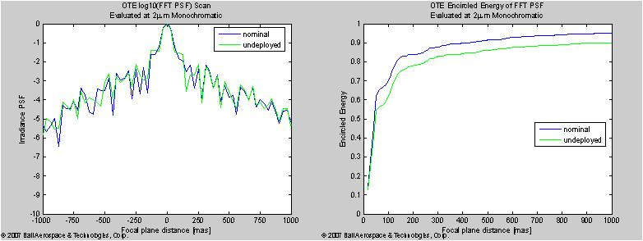
Motor Failure Prior to Deployment
SMA failure prior to or during the majority of deployment would be catastrophic due to the high sensitivity of telescope focal surface position to SMA despace position
Impact of a PMSA motor failure much more benign and can be accommodated with only minor degradation to telescope performance
  Would use remaining 5 hexapod actuators and radius of curvature actuator to align the failed segment to the remaining 17 segments in tilt and focus
  Results in a deterministic PSF that can be deconvolved from science images to mitigate the effect of the failure
  Effect of this on system performance, without taking advantage of deconvolution, is
  ~11% impact to Strehl and ~14% impact to encircled energy (shown above)

Slide 11
Motor Failure During Commissioning
Corrections During Each Phase
Segment Location & Positioning Phase
  Majority of PMSA tilt error corrected during this phase
  Significant SMA piston errors corrected during this phase as necessary
Segment-Level Wavefront Control
  Global Alignment provides correction of segment-level alignment errors and PMSA-level astigmatism
    Majority of PMSA piston, decenter, clocking alignment errors corrected
  Coarse MIMF uses data from across NIRCam FoV to find best global position for the SMA
    Majority of SMA tilt and decenter corrected here as long as NIRCam provides a good representation of ISIM alignment
Global Phasing
  If assumptions above regarding Coarse MIMF are valid, segments motions will be no more than a few hundred microns during Global Phasing
  If Coarse MIMF assumptions are not correct, millimeter-class adjustments of SMA decenter/tilt could be required during this phase
  Continued heavy use of the SMA is expected during this phase as commissioning iterates through Global Alignment (requires SMA motion +/- 400 um) and Multi-Instrument Multi-Field (MIMF) (requires SMA motion +/- 100 um)

Slide 12
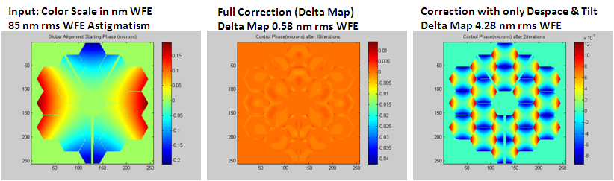
Motor Failure During Commissioning
Mitigating Considerations
Calculations of required motor use in baseline commissioning plan assume all degrees of freedom are used to best-optimize telescope performance
  Utilizing only PMSA strong degrees of freedom (despace/tilt) still provides compensation of low-order system errors with minor degradation to performance
  If a motor were to fail or if there was concern over a particular motor, decision could be made to only use strong degrees of freedom
  Current plan corrects strong degrees of freedom during the first iterations of Global Alignment and saves the weak degrees of freedom for later in the process
    Most significant corrections made earlier in motor life
    If SMA (needed for Global Alignment sensing) has motor failure during the process, lesser impact to not iterating through global alignment to correct weak degrees of freedom

Slide 13
Motor Failure During Commissioning
Mitigating Considerations
Generally WFS&C process always improves the state of the Observatory with a few notable exceptions; decision tree is closely followed to ensure consideration of necessity is made prior to large moves that could temporarily degrade the state of the telescope
  SMA use of +/- 400 um during Global Alignment sensing
  Potential large decenter/tilt of SMA during MIMF in Global Phasing
Because SMA is on-axis clocking orientation need not be controlled, allowing significant motion to recover from a failure at +/- 400 um from the ideal despace position and allowing large decentration to correct SMA global position in the presence of a motor failure

Slide 14
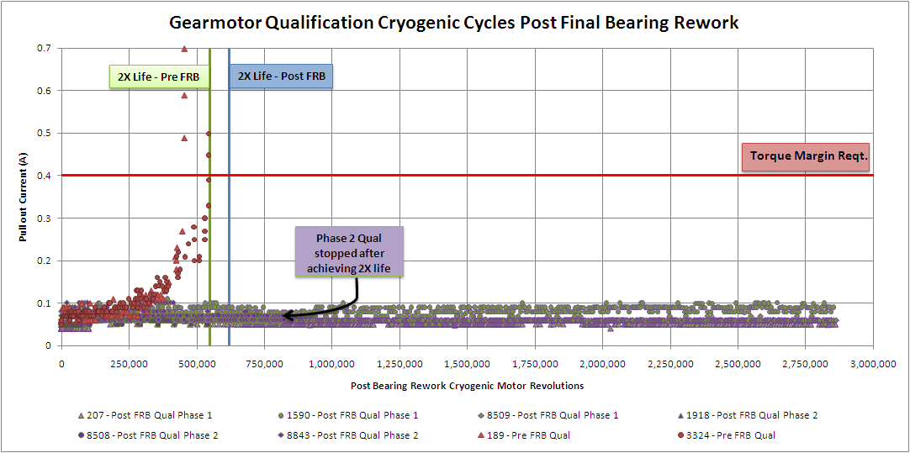
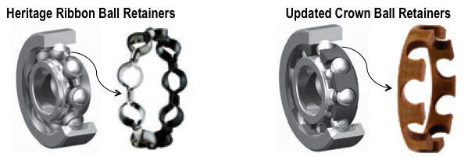
Motor Life Expectations
Historically JWST has had successive gearmotor design improvements for reliability and life
Motor history shows variability in life performance between motors, implying process variability
FRB investigation of 2011 qual tests uncovered several processing steps allowing variability in final motors that lead to debris generation from the steel ribbon retainer, causing motor failure
Final gearmotor design added process controls to eliminate sources of variability; steel ribbon retainer generating the debris was replaced with PGM-HT crown retainer
Qualification testing of 6 units (3 run to 2x life, 3 run to 7x life) show the design and process improvements implemented have significantly improved life and variability such that motor life should no longer be a concern for JWST

Slide 15
Summary
Careful planning has been implemented for the limited life resource of the mirror motors
There is a robust understanding of the expected motor use – both in flight and I&T
Monitoring plan is in place to assess motor health during I&T and prior to launch
I&T usage of motors has been minimized as practical
Analysis of failure data shows the number motor revs needed to complete flight deployment and WFS&C commissioning is 4-5x less than the available revs between detectable onset of failure and motor failure
Impact of motor failure in flight has been assessed by motor phase
  During majority of commissioning process motor failure poses only limited risk to Observatory performance
Decision tree process is in place when considering large changes in configuration late in the commissioning process that could result in temporary degradation to Observatory Performance
Qualification data from final motor design shows robust motor design and assembly process has been put in place
  Shows no degradation in motor performance after 7x life

Slide 16
Acknowledgements & References
Acknowledgments
Work was supported in part by the Ball Aerospace & Technologies Corp. subcontract with Northrop Grumman Aerospace Systems under the JWST contract NAS5-02200 with NASA Goddard Space Flight Center
The JWST system is a collaborative effort involving NASA, ESA, CSA, and the astronomy community
References
[1] Knight, J. S, et al., “Observatory Alignment of the James Webb Space Telescope,” SPIE 8442-131, these proceedings (2012).
[2] http://www.weibull.com/hotwire/issue14/relbasics14.htm.
[3] Lloyd Schlitzer, “Monte Carlo Evaluation and Development of Weibull Analysis Techniques”, ASLE Transactions,Vol. 9, Iss. 4, 1966.
[4] Jessica Gersh-Range, et al, “Minimizing the Wavefront Error Degradation for Primary Mirror Segments with Failed Hexapod Actuators”, Opt. Eng. 51, 011005 (2012).
[5] Knight, J. S. “Effect of Single Segment Failure to Deploy (Maverick Segment), Rev B,” JWST Technical Document 06-JWST-0410.
[6] D. Scott Acton, et. al., “Wavefront Sensing and Controls for the James Webb Space Telescope,” SPIE 8442-087, these proceedings (2012).
[7] Gallagher, Ben, “JWST Gearmotor FRB Final Summary Report,” Ball Aerospace & Technologies Corp. JWST Systems Engineering Report (2012).

